Slide 1
Electronics Shop
Lecture: HITIMANA ERIC

Slide 2

Introduction
Our shop aims to provide the services to those who don’t want to come to the market always and tend to use the online services , the Electronic shop project will provide the Buy and Sell services as well as Delivery.

Slide 3
Our Main Goals
To allow Clients to access the shop wherever they are
To reduce time taken by customers to look for products
To attain maximum hours of working
To allow easy advertisement
To allow easily management of inventory
To track how the business is going
To allow customers to know about prices of electronics products easily

Slide 4

The Main users
The main users of our application are:
Customer
Supplier
Admin
Super admin

Slide 5
What Clients can do?
View All products
View Single Product
Add to cart
View Cart
Checkout
Press an Order

Slide 6
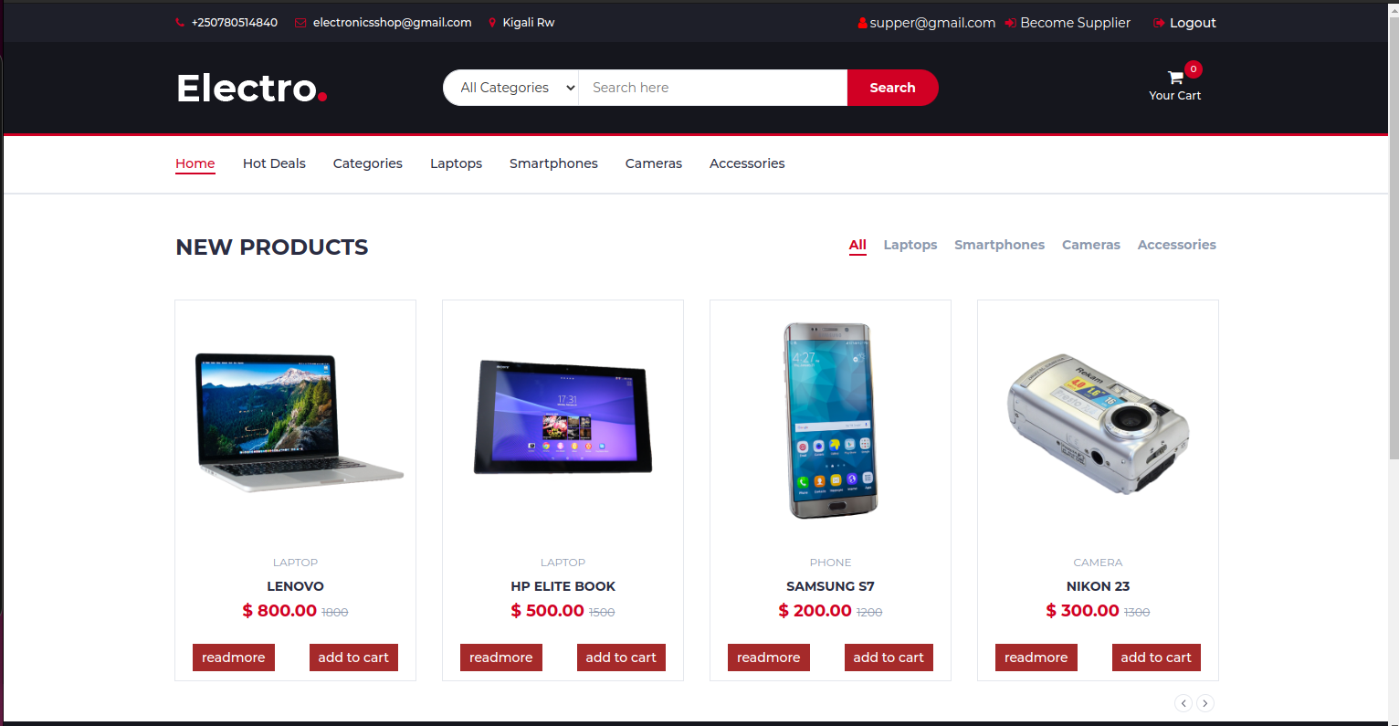
What users can see and do

Slide 7
What Suppliers and Admins can do
View system summary
View All users (only Admins)
View All products
Add New,Delete and View single Product
Approve Supplier Applications
See Orders

Slide 8
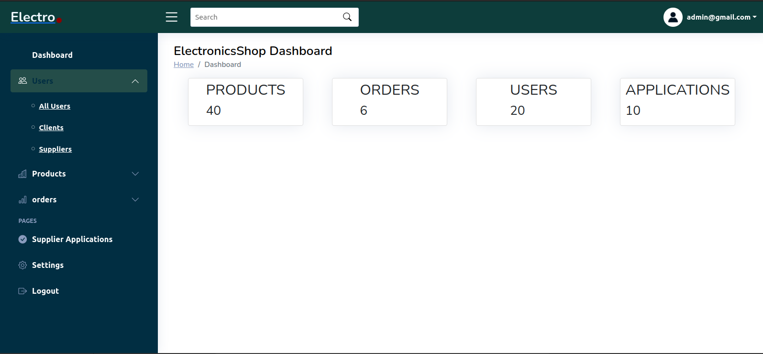
Dashboard

Slide 9
Team Members
NGARUKIYIMANA Sostene 220004083
BAZAMBANZA Abdoulkalim 220000529

Slide 10
Gratitudes
Lecturer: HITIMANA ERIC
University of rwanda
KTU developers
Dolphix Electronics
Electronics Shop

